Slide 1
Fleet Management System

Slide 2
CONTRIBUTORS
NIKHIL KANDEKAR
NIKITA KRISHNA
PREM OSWAL
M23AID046
M23AID026
M23AID037

Slide 3
TABLE OF CONTENTS
Introduction
System Architecture
Technology Stack
Kafka Producer & Consumer
Data Storage (MongoDB)
REST API (Express)
Frontend (React)
Influx DB
Data Schema
JMeter Testing
Demo Screenshots
Future Enhancements
Conclusion

Slide 4
Introduction
In the modern transportation and logistics industry, efficient fleet management is critical to optimizing operations, reducing costs, and improving safety. Managing a fleet efficiently is challenging due to several key issues:
Lack of Real-Time Data: Fleet operators often lack visibility into vehicle performance and driver behavior, leading to delays in decision-making.
Fragmented Data: Telemetry data is often scattered, making it hard to analyze and act upon quickly.
Incident Detection: There's no automated system to detect critical incidents like accidents or sudden speed drops in real time.
Driver Behavior Analysis: Monitoring and optimizing driver performance to improve safety and fuel efficiency is difficult with traditional methods.
To address these challenges, our fleet management system provides real-time tracking of vehicle data like speed, location, fuel level and also alerts for possibility of accident.

Slide 5
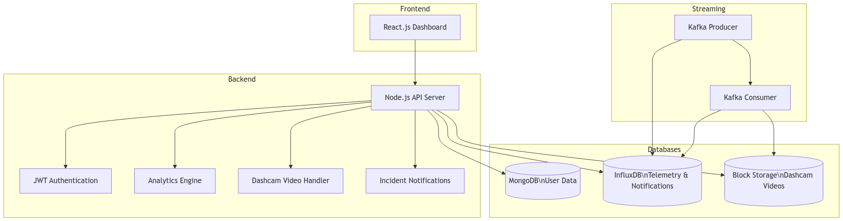
System Architecture

Slide 6
Technology Stack
01
02
03
04
04
Kafka
MongoDB
To relay messages
For Storing User and Video Data
Express
ReactJS
Backend/Middleware
To show analytics
Influx DB
To store real time IOT telemetry data

Slide 7
Kafka
Purpose: Kafka enables real-time streaming and processing of vehicle telemetry data from IoT devices.
Why Kafka?
High throughput: Handles large data streams efficiently.
Fault-tolerant: Ensures data reliability even during failures.
Scalable: Easily manages increasing data volume with independent producers and consumers.
Producer-Consumer Model:
Producer: Sends vehicle telemetry (speed, location, fue) to Kafka topics.
Consumer: Listens to the topic, performs some calculation like distance travelled using coordinates and stores data in MongoDB, and analyzes it for insights like accident detection.

Slide 8
MongoDB
Purpose: MongoDB stores real-time vehicle telemetry data in a flexible, document-based format.
How it’s used?
Stores users data like role, username and password.
Stores video path link for frontend to fetch from blockstore or cloud
Why MongoDB?
Flexible schema: Handles varying data formats easily.
Scalability: Supports large-scale data storage and high-speed read/write operations.

Slide 9
Express
Purpose: Express is used to create APIs that serve vehicle telemetry data and analytics to the frontend.
How it’s used?
Provides RESTful APIs to fetch telemetry data and analytics (e.g., distance, fuel consumption).
Enables accident detection alerts and fetching the latest vehicle locations.
Why Express?
Lightweight: Efficiently handles HTTP requests and responses.
Fast development: Simplifies building and managing APIs.
Middleware support: Easily integrates features like CORS and error handling.

Slide 10
ReactJS
Purpose:ReactJS is used for building the user interface of the application, enabling a dynamic and responsive experience for users.
How it’s used?
Renders telemetry data and analytics on the frontend, allowing users to visualize vehicle performance and status.
Manages the state of the application for real-time updates (e.g., displaying live telemetry data).
Why ReactJS?
Component-based architecture: Facilitates reusability and maintainability of UI components.
Virtual DOM: Enhances performance by minimizing direct DOM manipulations, leading to faster rendering.

Slide 11
Influx DB
Purpose: Influx stores real-time vehicle telemetry data in a flexible, time series-based format.
How it’s used?
Stores vehicle data (speed, location, fuel level, distance travelled) received from Kafka in a structured schema.
Enables querying for analytics, such as distance traveled, fuel consumption, and accident detection.
Why MongoDB?
Flexible schema: Handles varying telemetry data formats easily.
Scalability: Supports large-scale data storage and high-speed read/write operations.
Real-time analytics: Allows efficient querying and retrieval of live telemetry data for insights.

Slide 12
JMeter
Used for load testing the application to evaluate performance and scalability.
Simulates multiple users sending requests to Express APIs, measuring response times and throughput.
Open-source, cost-effective, and widely adopted.
Supports various protocols and integrations.
Provides comprehensive reporting with detailed metrics for performance analysis.

Slide 13
JMeter Results
Number of Users
Throughput
Received KB/sec
Sent KB/sec
Consumer
5566
31.9/sec
1570.11
1.7
Producer
416059
1954.5/sec
13.36
0

Slide 14
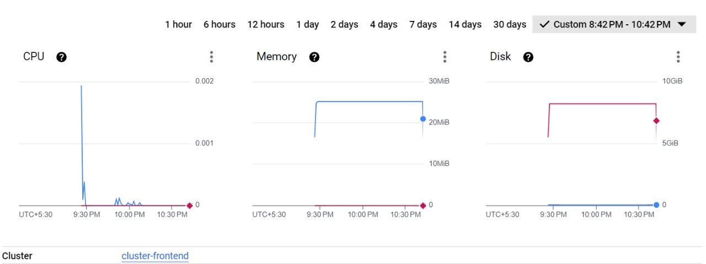
Cloud and docker result

Slide 15
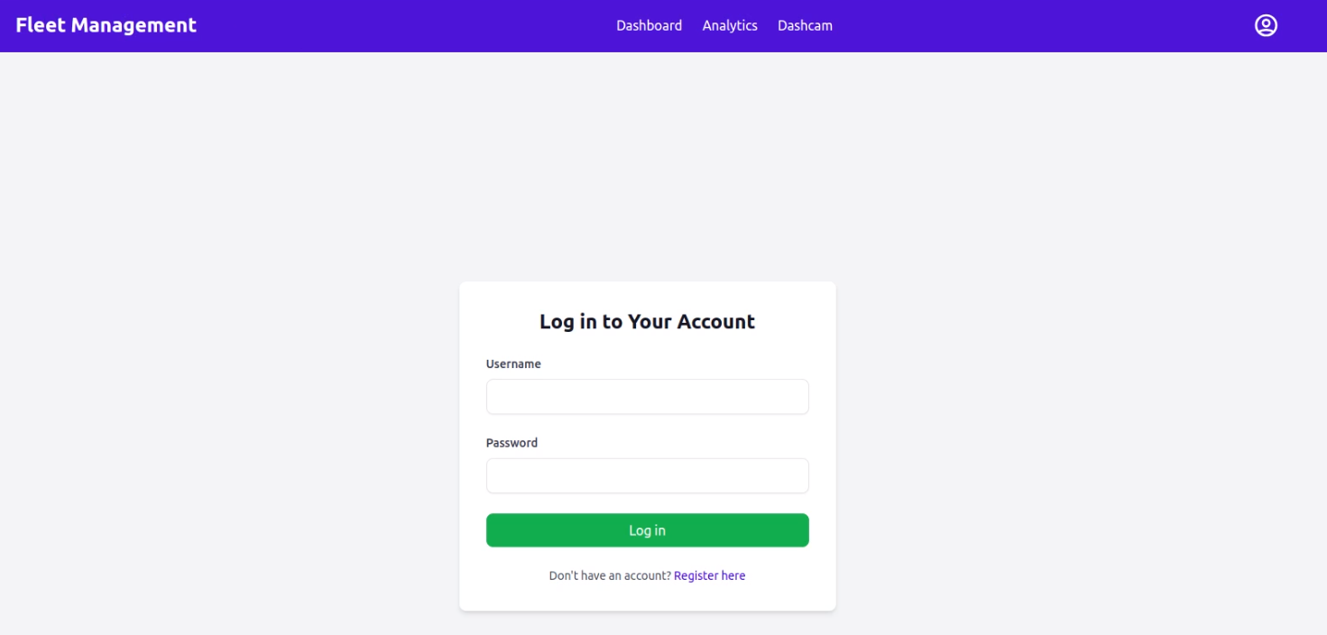
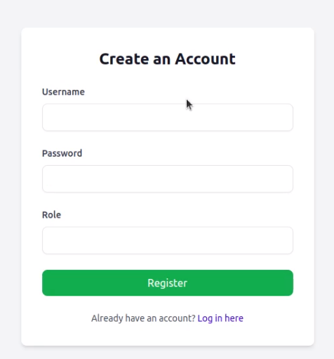
Frontend

Slide 16
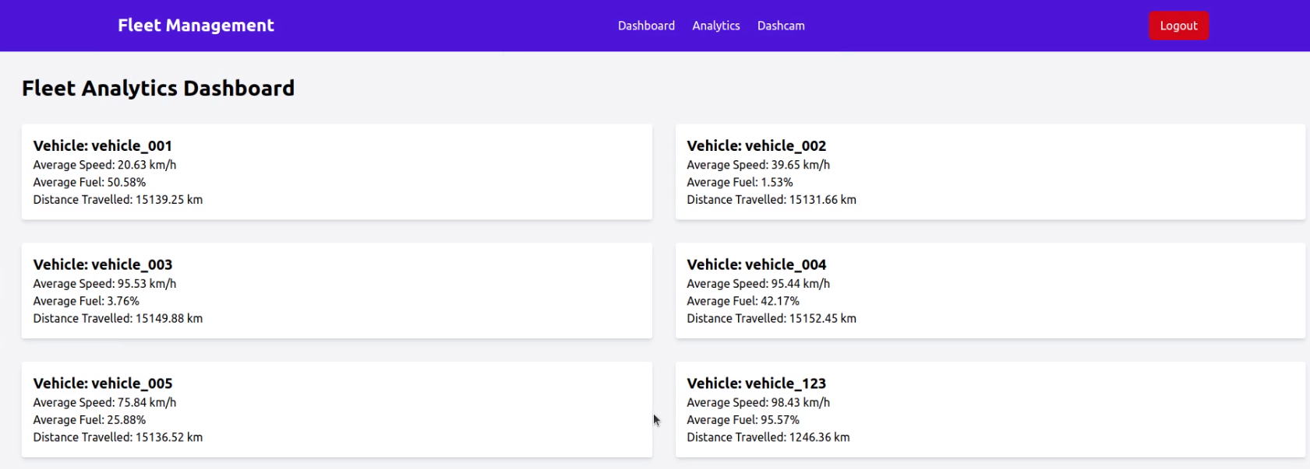
Analytics

Slide 17
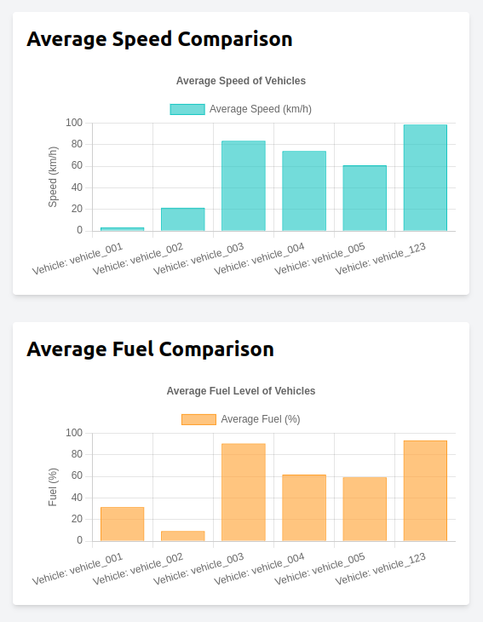
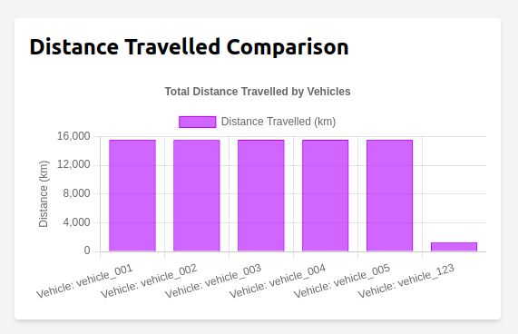
Analytics

Slide 18
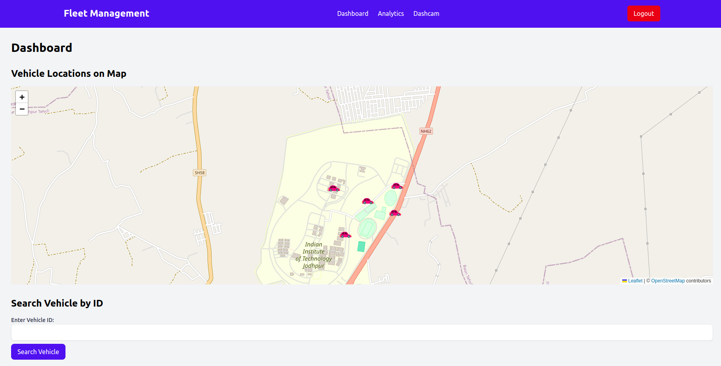
Dashboard UI

Slide 19
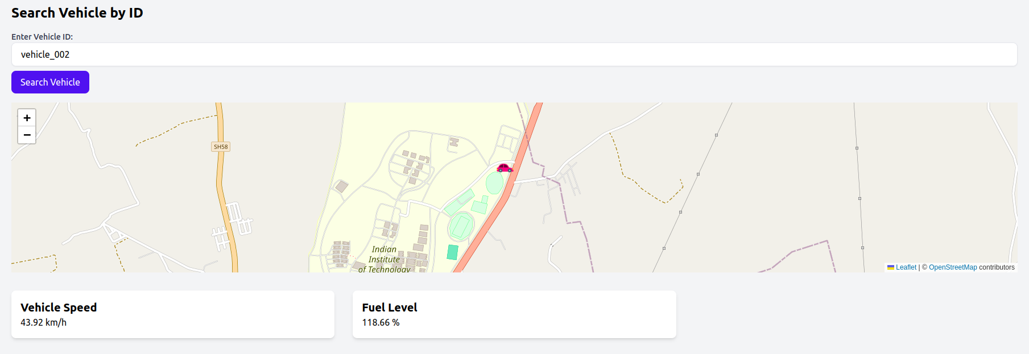
Dashboard UI

Slide 20
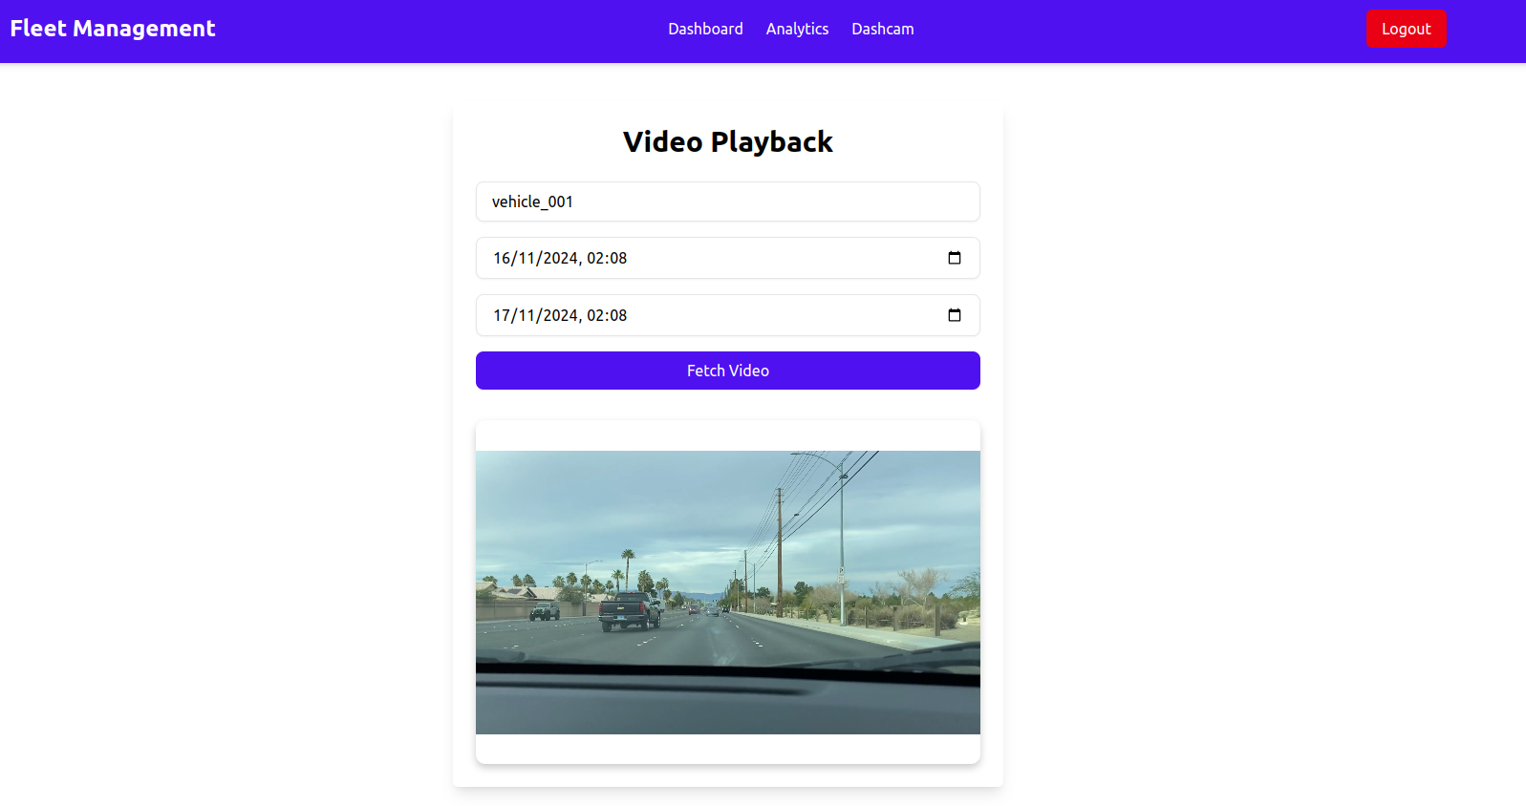
Dashcam UI

Slide 21
Future Enhancement
AI based Analytics where user will enter prompt on UI dashboard to get different analytics generated.
AI based route optimization and suggestions to driver based on web interface or mobile app based on vehicles fuel data, drivers riding pattern and current traffic condition in area.
Scalability improvements or integrations with other systems

Slide 22
Conclusion
The fleet management system unifies key functions like GPS tracking, vehicle diagnostics, and driver safety into a single platform for optimized operations.
The system improves operational efficiency by automating tasks, reducing downtime, and providing actionable insights. It enhances driver safety, enables better route planning, and offers comprehensive fleet diagnostics and fuel management, all contributing to reduced costs and improved productivity.
The system successfully achieves its goal of streamlining operations and providing data-driven solutions to enhance business performance.

Slide 23
Thank You

